Slide 1
Continuous Control with Deep Reinforcement Learning
2016 ICLR
Timothy P. Lillicrap, et al. (Google DeepMind)
Presenter : Hyemin Ahn

Slide 2

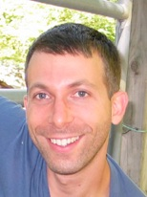
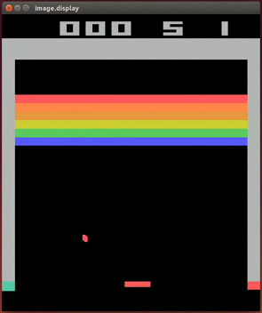
Introduction
Another work of
Deep Learning
+ Reinforcement Learning
from Google DEEPMIND !
Extended their Deep Q Network,
which is dealing with discrete action space,
to continuous action space.

Slide 3

Results : Preview

Slide 4
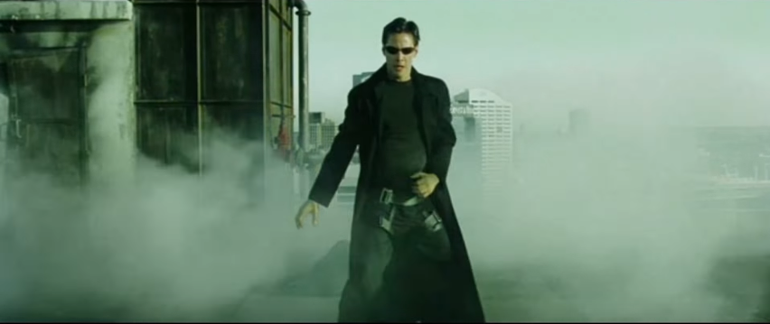
Reinforcement Learning : overview
How can we formulize our behavior?
Agent

Slide 5
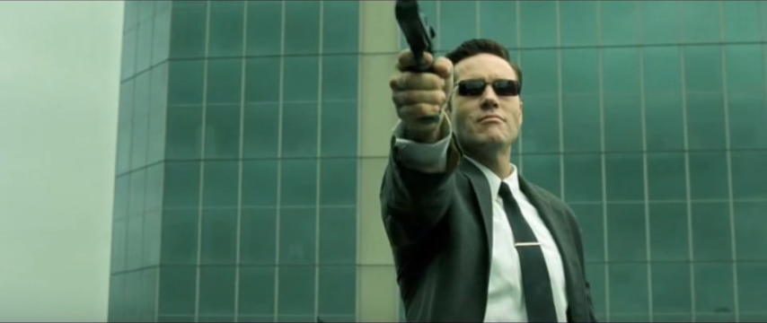

Reinforcement Learning : overview
At each time $t$,
the agent receives an observation $x_{t}$
from environment $E$
such gun
so many bullets
Wow
so scare
nice suit btw

Slide 6
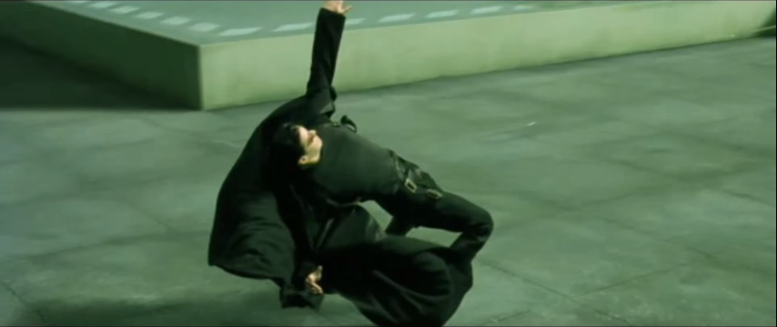



Reinforcement Learning : overview
The agent takes
an action $a_{t}∈𝒜⊆ℝ^{N}$,
and receives a scalar reward $r_{t}$.
$$x_{t}$$
$$a_{t}$$

Slide 7
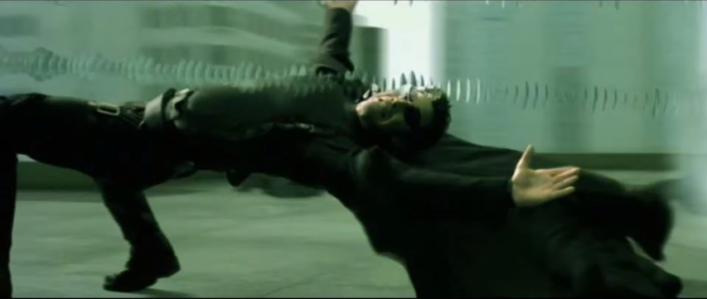
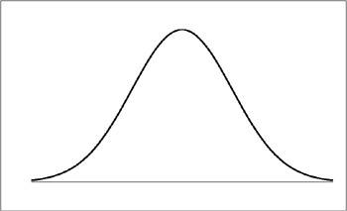



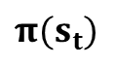
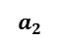
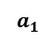
Reinforcement Learning : overview
$$π(s_{t})$$
$$a_{1}$$
$$a_{2}$$
$$a_{2}$$
$$a_{1}$$
For selecting the action, there is a policy $π:𝓢→𝓟\left(𝓐\right)$,
which maps states to probability distribution over actions.

Slide 8
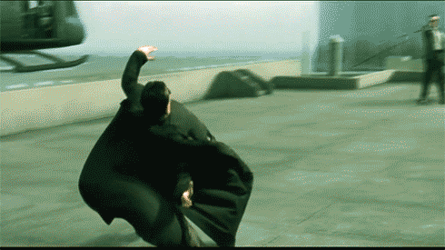
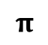
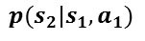
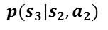
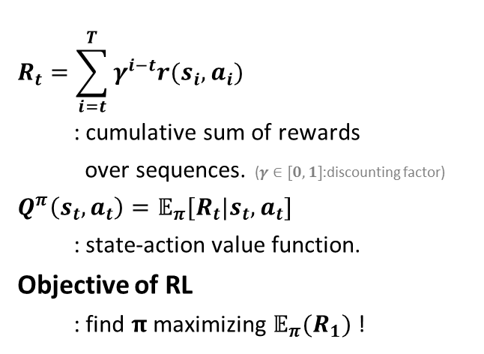
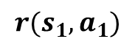
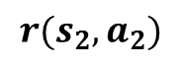
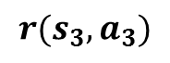


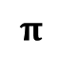


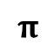


Reinforcement Learning : overview
$$s_{1}$$
$$s_{2}$$
$$s_{3}$$
$$π$$
$$π$$
$$π$$
$${ a}_{1}$$
$$p(s_{2}|s_{1}, a_{1})$$
$${ a}_{2}$$
$$p(s_{3}|s_{2}, a_{2})$$
$${ a}_{3}$$
M
D
P
$$r(s_{1}, a_{1})$$
$$r(s_{2}, a_{2})$$
$$r(s_{3}, a_{3})$$
$$R_{t}=\sum_{i=t}^{T}{γ^{i−t}r(s_{i}, a_{i})}$$
: cumulative sum of rewards
over sequences. ($γ∈[0,1]$:discounting factor)
$$Q^{π}\left(s_{t},a_{t}\right)={𝔼_{π}[R}_{t}|s_{t},a_{t}]$$
: state-action value function.
Objective of RL
: find $π$ maximizing ${𝔼_{π}(R}_{1})$ !

Slide 9
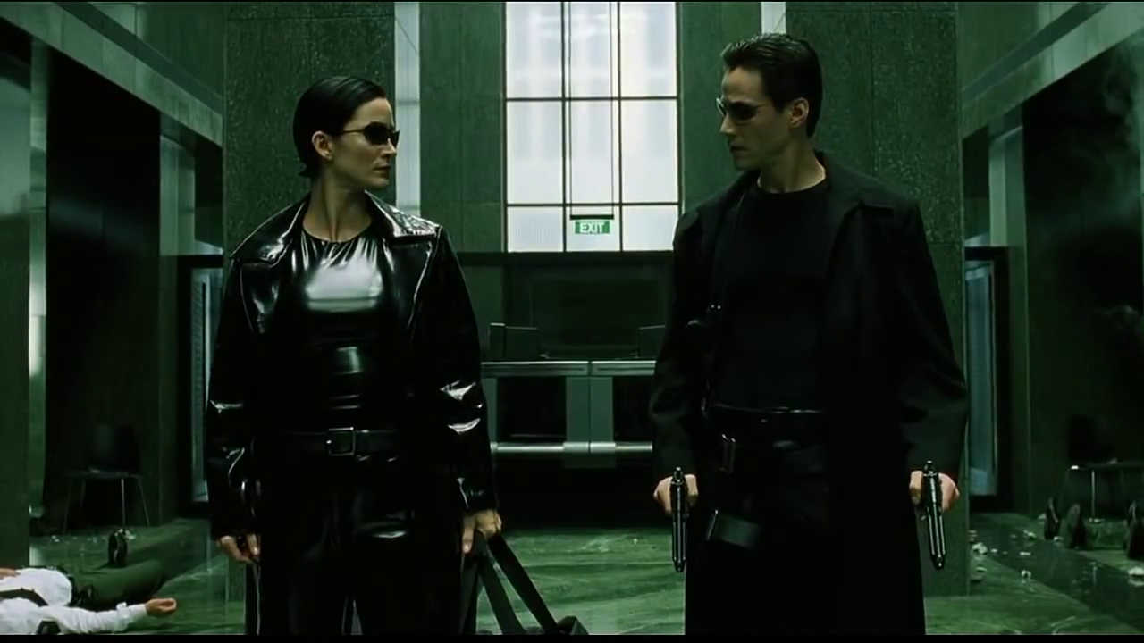
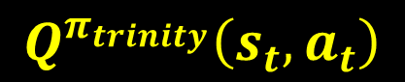
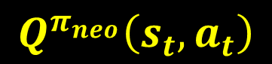

Reinforcement Learning : overview
$$<$$
$$Q^{π_{trinity}}\left(s_{t},a_{t}\right)$$
$$Q^{π_{neo}}\left(s_{t},a_{t}\right)$$

Slide 10
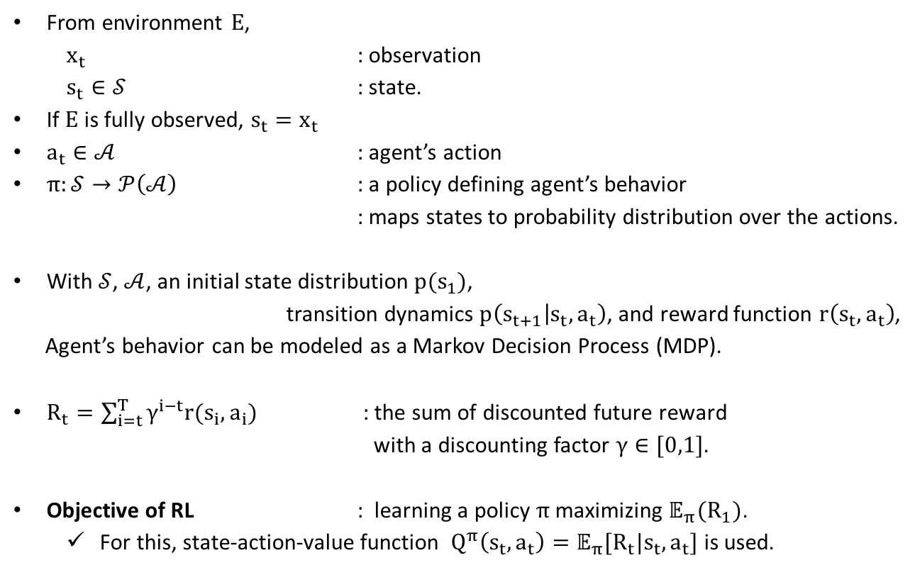
Reinforcement Learning : overview
From environment $E$,
$x_{t}$ : observation
$s_{t}∈𝒮$ : state.
If $E$is fully observed, ${s_{t}=x}_{t}$
$a_{t}∈𝒜$ : agent’s action
$π:𝒮→𝒫\left(𝒜\right)$ : a policy defining agent’s behavior
: maps states to probability distribution over the actions.
With $𝒮$, $𝒜$, an initial state distribution $p(s_{1})$,
transition dynamics $p\left(s_{t+1} | s_{t},a_{t}\right)$, and reward function $r\left(s_{t},a_{t}\right)$,
Agent’s behavior can be modeled as a Markov Decision Process (MDP).
$R_{t}=\sum_{i=t}^{T}{γ^{i−t}r(s_{i}, a_{i})}$ : the sum of discounted future reward
with a discounting factor $γ∈[0,1]$.
Objective of RL : learning a policy $π$ maximizing ${𝔼_{π}(R}_{1})$.
For this, state-action-value function $Q^{π}\left(s_{t},a_{t}\right)={𝔼_{π}[R}_{t}|s_{t},a_{t}]$ is used.

Slide 11
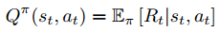
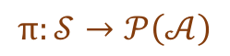
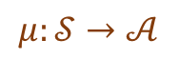
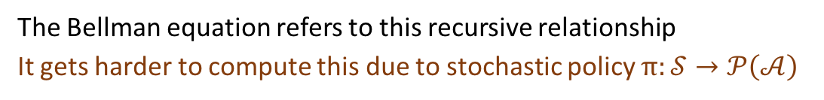
Reinforcement Learning : Q-Learning
The Bellman equation refers to this recursive relationship
It gets harder to compute this due to stochastic policy $π:𝒮→𝒫\left(𝒜\right)$
Let us think about the deterministic policy instead of stochastic one
$$π:𝒮→𝒫\left(𝒜\right)$$
$$μ:𝒮→𝒜$$
Q-learning is finding , the greedy policy
Can we do this in continuous action space?

Slide 12
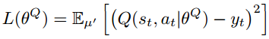
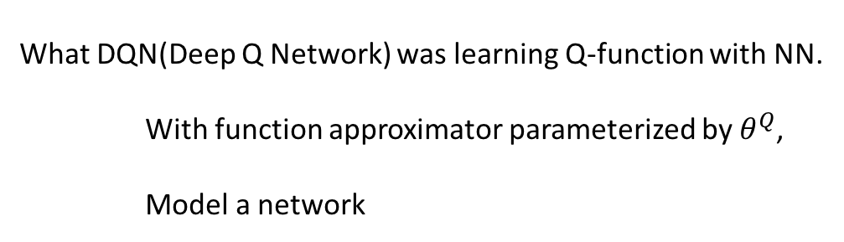

Reinforcement Learning : continuous space?
What DQN(Deep Q Network) was learning Q-function with NN.
With function approximator parameterized by $θ^{Q}$,
Model a network
Finding $θ^{Q}$ minimizing the loss function
Problem 1: How can we know this real value?

Slide 13
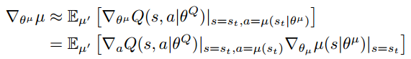
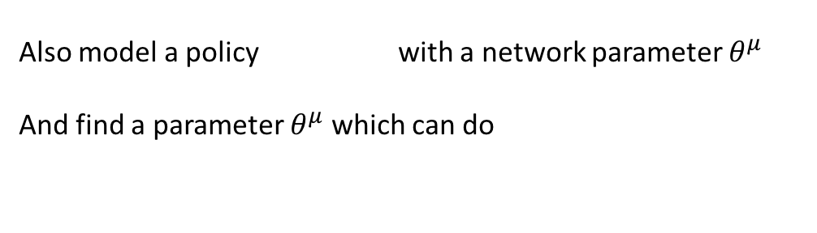
Reinforcement Learning : continuous space?
Anyway, if assume that we know
How can we find in a continuous action space?
Also model a policy with a network parameter $θ^{μ}$
And find a parameter $θ^{μ}$ which can do
The gradient of the policy’s performance can be defined as,
Silver, David, et al. "Deterministic policy gradient algorithms." ICML. 2014.
Problem 2: How can we successfully explore this action space?

Slide 14
Reinforcement Learning : continuous space?
Objective : Learn and in a continuous action space!
Both are neural network
Problem of
How can we know this real value?
Problem of
How can we successfully explore this action space?
Authors suggest to use additional ‘target networks’
and

Slide 15
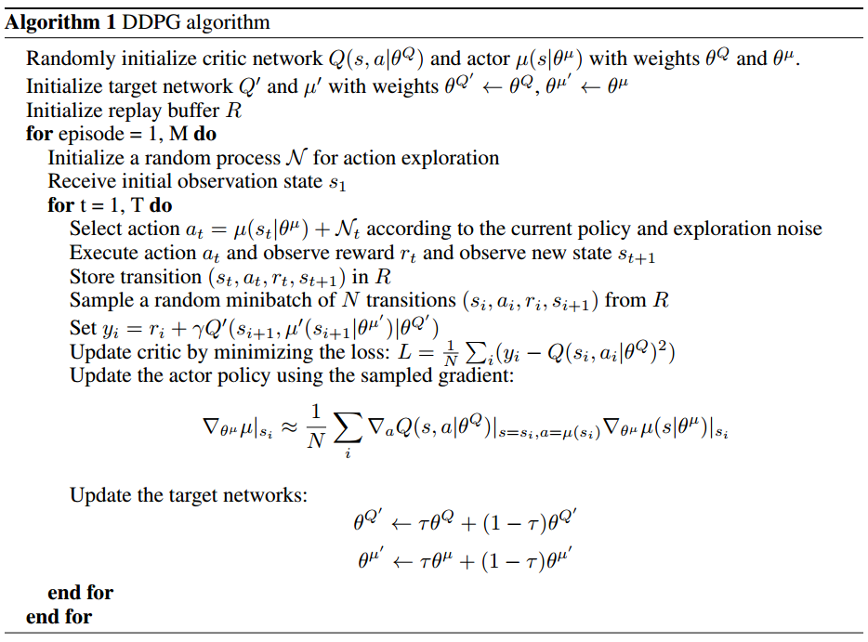
DDPG(Deep DPG) Algorithm

Slide 16
DDPG(Deep DPG) Algorithm
Our objective

Slide 17
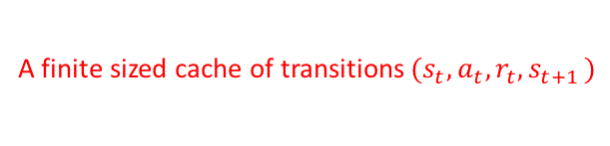
DDPG(Deep DPG) Algorithm
Our objective
A finite sized cache of transitions$(s_{t},a_{t}, r_{t}, s_{t+1 })$

Slide 18

DDPG(Deep DPG) Algorithm
Our objective
A finite sized cache of transitions$(s_{t},a_{t}, r_{t}, s_{t+1 })$

Slide 19
DDPG(Deep DPG) Algorithm
Our objective
A finite sized cache of transitions$(s_{t},a_{t}, r_{t}, s_{t+1 })$
Explored reward + sum of future rewards from target policy network

Slide 20
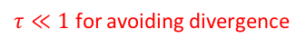
DDPG(Deep DPG) Algorithm
Our objective
A finite sized cache of transitions$(s_{t},a_{t}, r_{t}, s_{t+1 })$
Explored reward + sum of future rewards from target policy network
$τ≪1$ for avoiding divergence

Slide 21
DDPG(Deep DPG) Algorithm
Exploration
Assume these are right, real target networks

Slide 22
Experiment : Results

Slide 23


